Slide 1
Capturing Swarms

Slide 2
What are Swarms
Swarming is the natural means of reproduction of honey bee colonies.
A new honey bee colony is formed when the queen bee leaves the colony with a large group of worker bees.
In the prime swarm, about 60% of the worker bees leave the original hive location with the old queen. This swarm can contain thousands to tens of thousands of bees.
Swarming is mainly a spring phenomenon, usually within a two- or three-week period depending on the locale, but occasional swarms can happen throughout the producing season.
Secondary afterswarms may happen but are rare. Afterswarms are usually smaller and are accompanied by one or more virgin queens. Sometimes a beehive will swarm in succession until it is almost totally depleted of workers

Slide 3
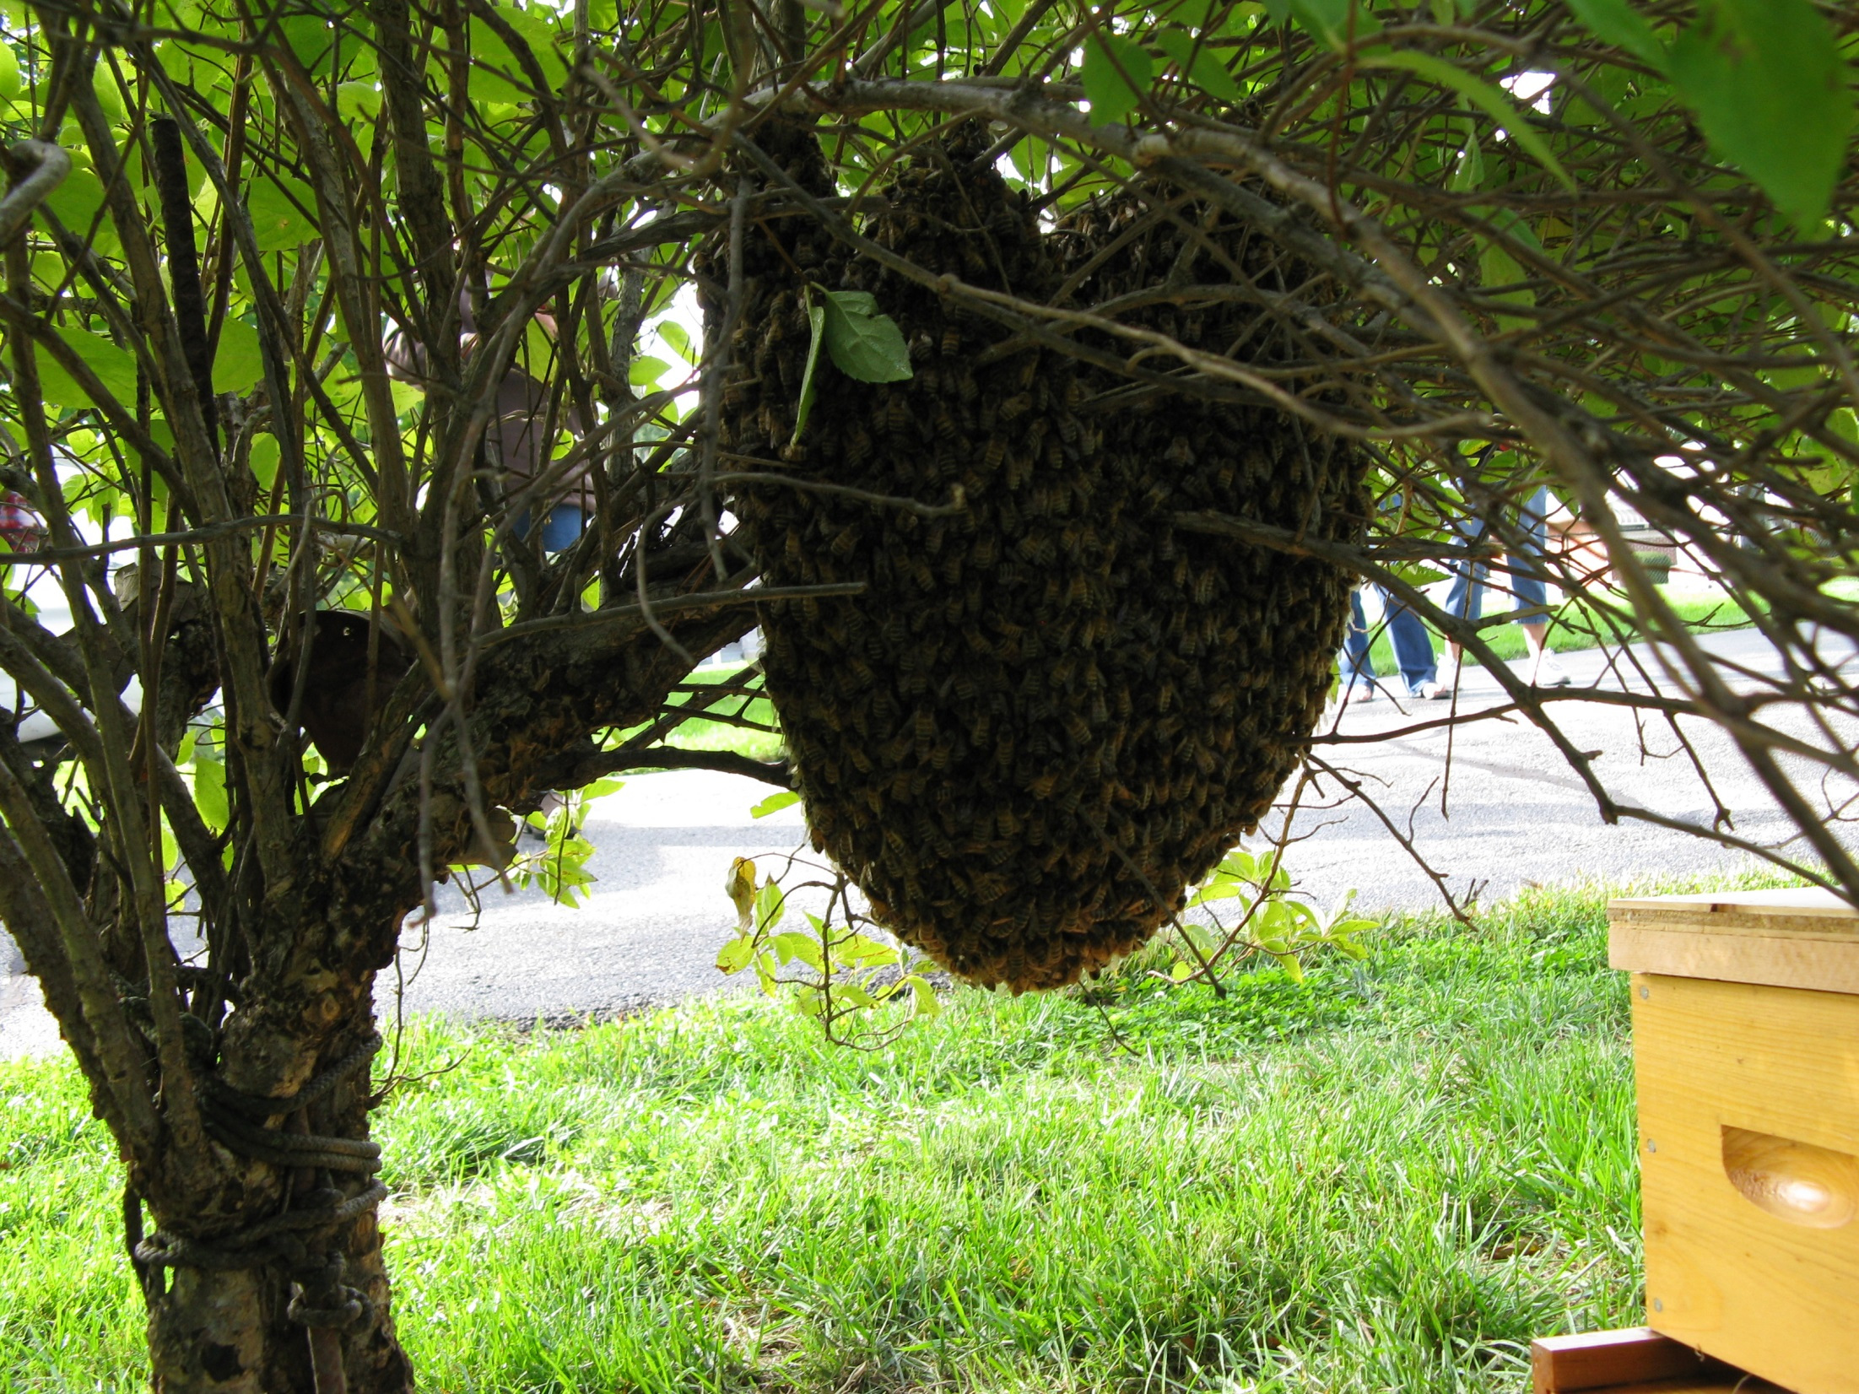

Slide 4
Get Your Name on a List…
In order for you to get called about swarms the public needs to know that you are beekeeper and are able to catch swarms.
On the web:
www.bees-on-the-net.com
www.beeremovalsource.com
Other ways:
Give your name to the local police as a beekeeper and that you are looking for swarms.
Give you name to the local Extension Office.

Slide 5
Swarms are Fun…
A swarm of honey bees is a biological wonder and can be a great teaching moment.
A swarm encounter for those who don’t keep bees can become a life-long memory!
This is a time for the beekeeper to be a “hero” and save those around from the “threatening pest.”
For the beekeeper these are free bees!

Slide 6
What to ask when you get a call
How long have they been there?
How high off the ground are they – where are they located?
Are they, in fact, honey bees?
Where are you located? (Google maps and navigation is wonderful on a smart phone)
How large is the swarm?

Slide 7
What to Bring
A hive (regular size or nuc) with frames of foundation or drawn comb. (you could also use a box/bucket with ventilation for temporarily holding the bees)
Screen to close up the entrance.
Staple gun to hold the screen.
A bucket with lid for transferring bees.
A hive strap to hold everything together.
Pruning shears
A step ladder for swarms that are high off the ground.
Bee brush
Smoker
Protective clothing
An old sheet /tarp or piece of plywood.
Bee vac

Slide 8
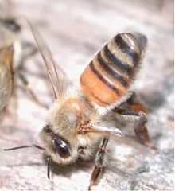
What’s the secret…
The secret is to get a good portion of the bees to fan at the entrance of the hive exposing their Nasanov gland. The Nasonov pheromone acts as an attractant to tell the other bees of the new home.

Slide 9
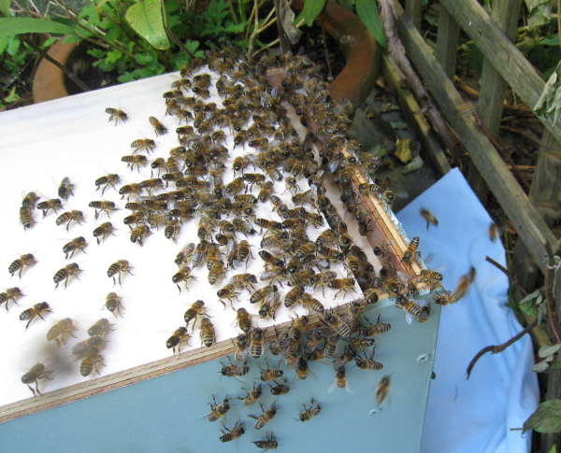

Slide 10
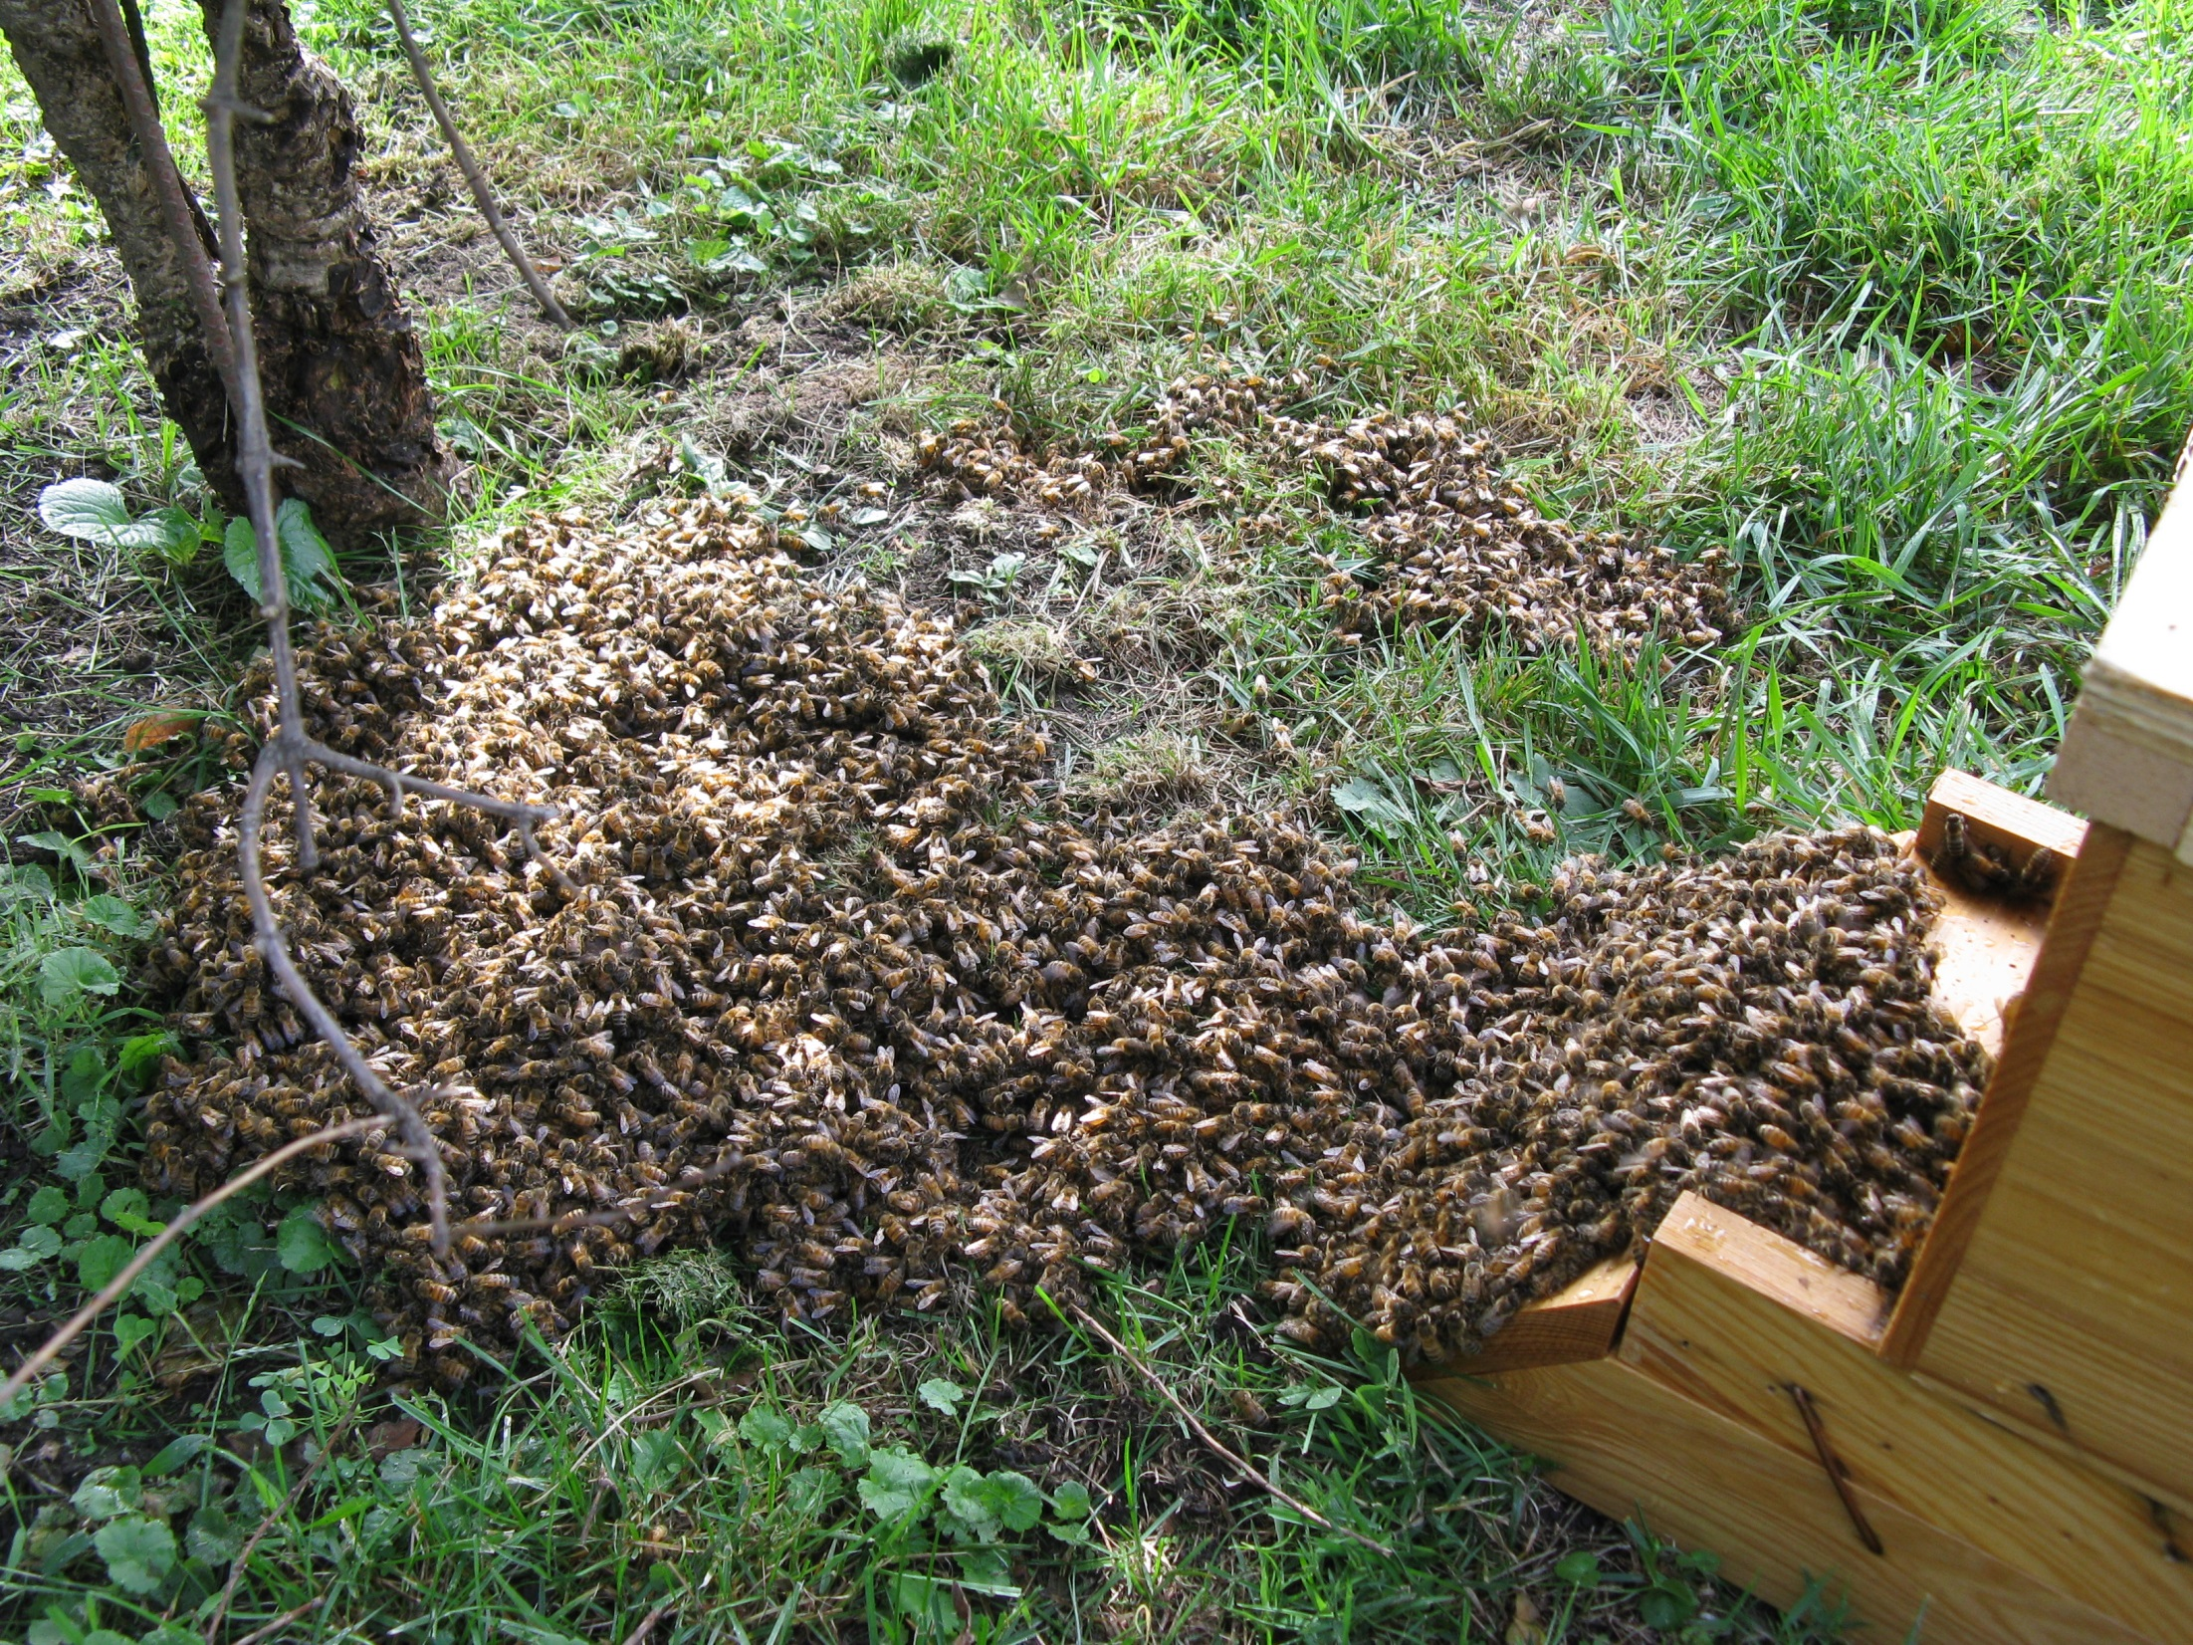

Slide 11
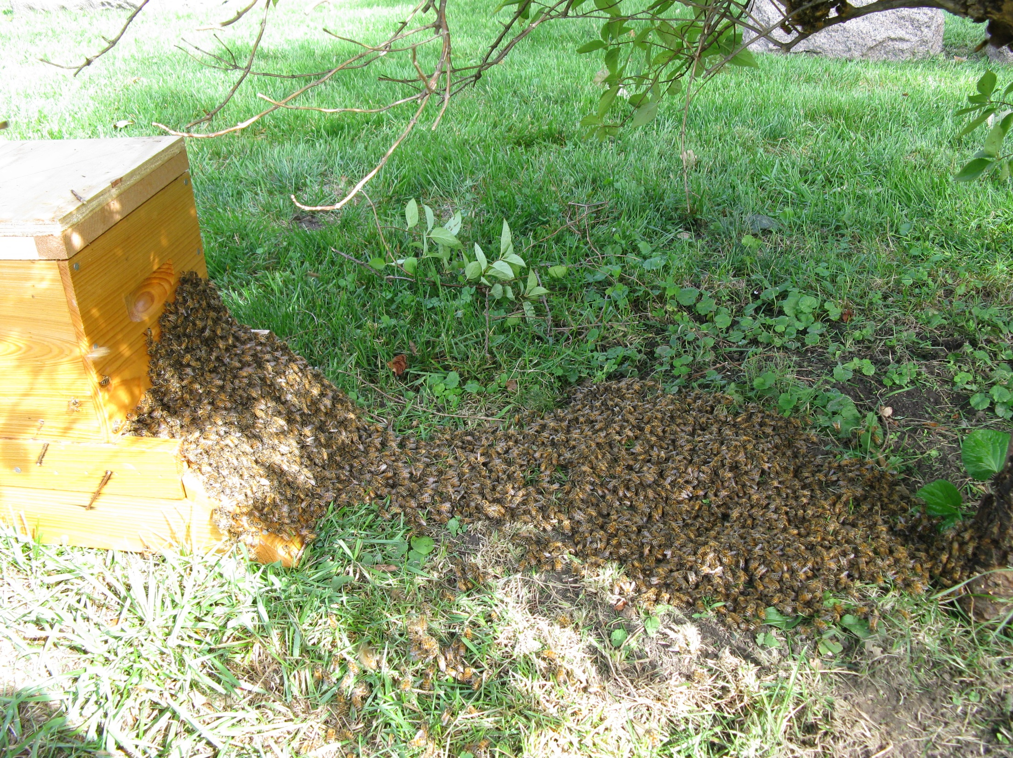

Slide 12
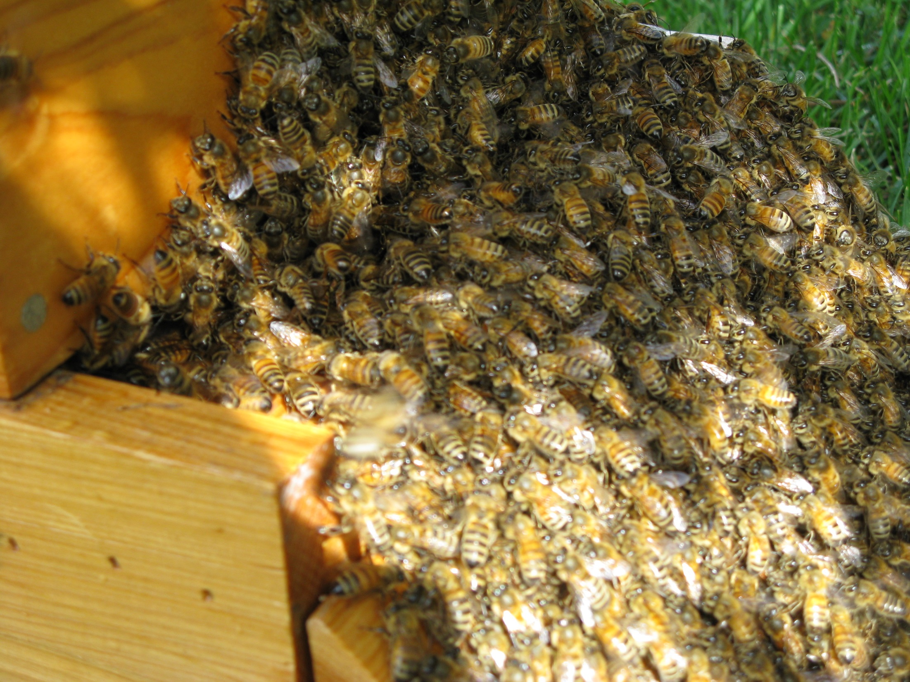

Slide 13
When everybody is in…
Close up the entrance with the screen and staples
Strap the hive together.
Give those who called you a bottle of honey.
Place the hive in your apiary and enjoy.
Feeding your new bees will help them along, but is not necessary.
Give the bees a week and check to see how the queen is laying / temperament.
QUESTIONS

